Slide 1


ECEN 403
Final Presentation
Matrix 1 / “Scooter Juice”
Connor Cottongame
John Dusterhoff
Blake Hallam
Oscar Rubio
TA: Hailey Ward
Sponsor: Prof Prasad Enjeti

Slide 2


Project Summary
Problem statement:
Current electric scooter chargers are bulky and inconvenient to use, requiring large, external rectifiers to charge their batteries, much like a laptop charger.
Our Solution:
This team will design and build an IOBC (Integrated On-Board Charger), allowing the scooter to be charged directly from an AC power source.
This charger will use the existing inverter components in the scooter as a rectifier in order to charge the battery.

Slide 3
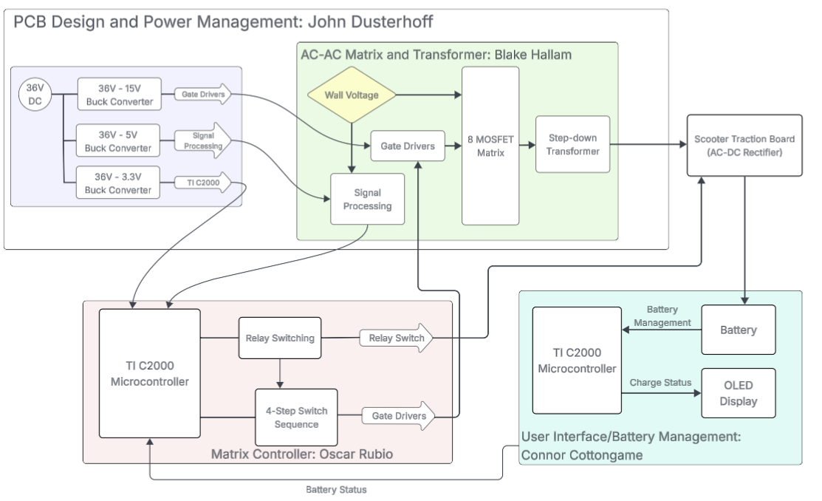
System Overview
Notes:
Cloud server and database

Slide 4
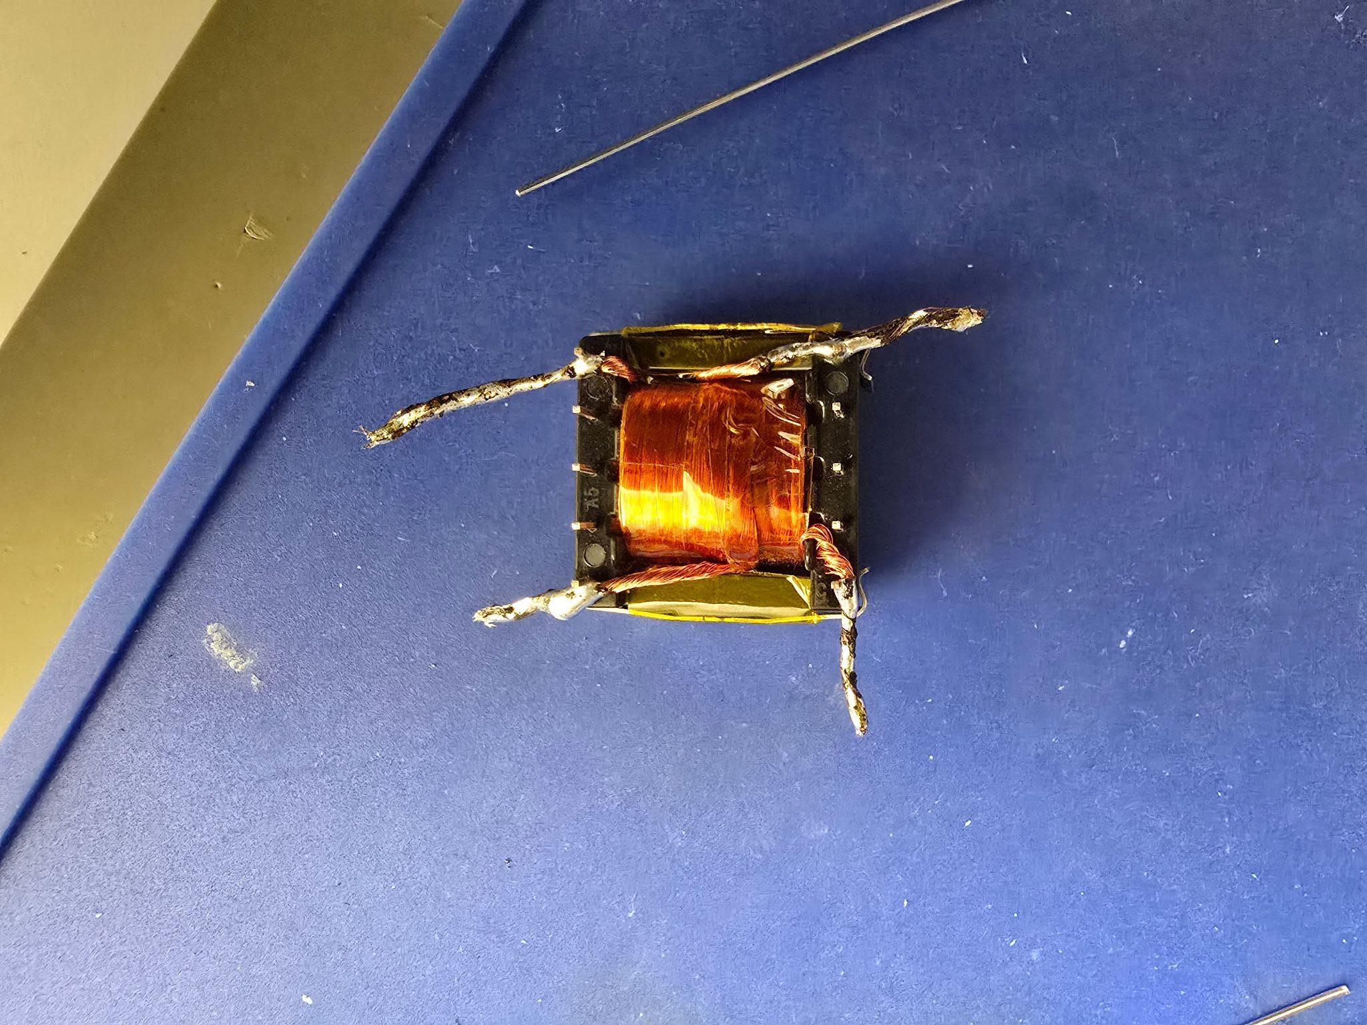
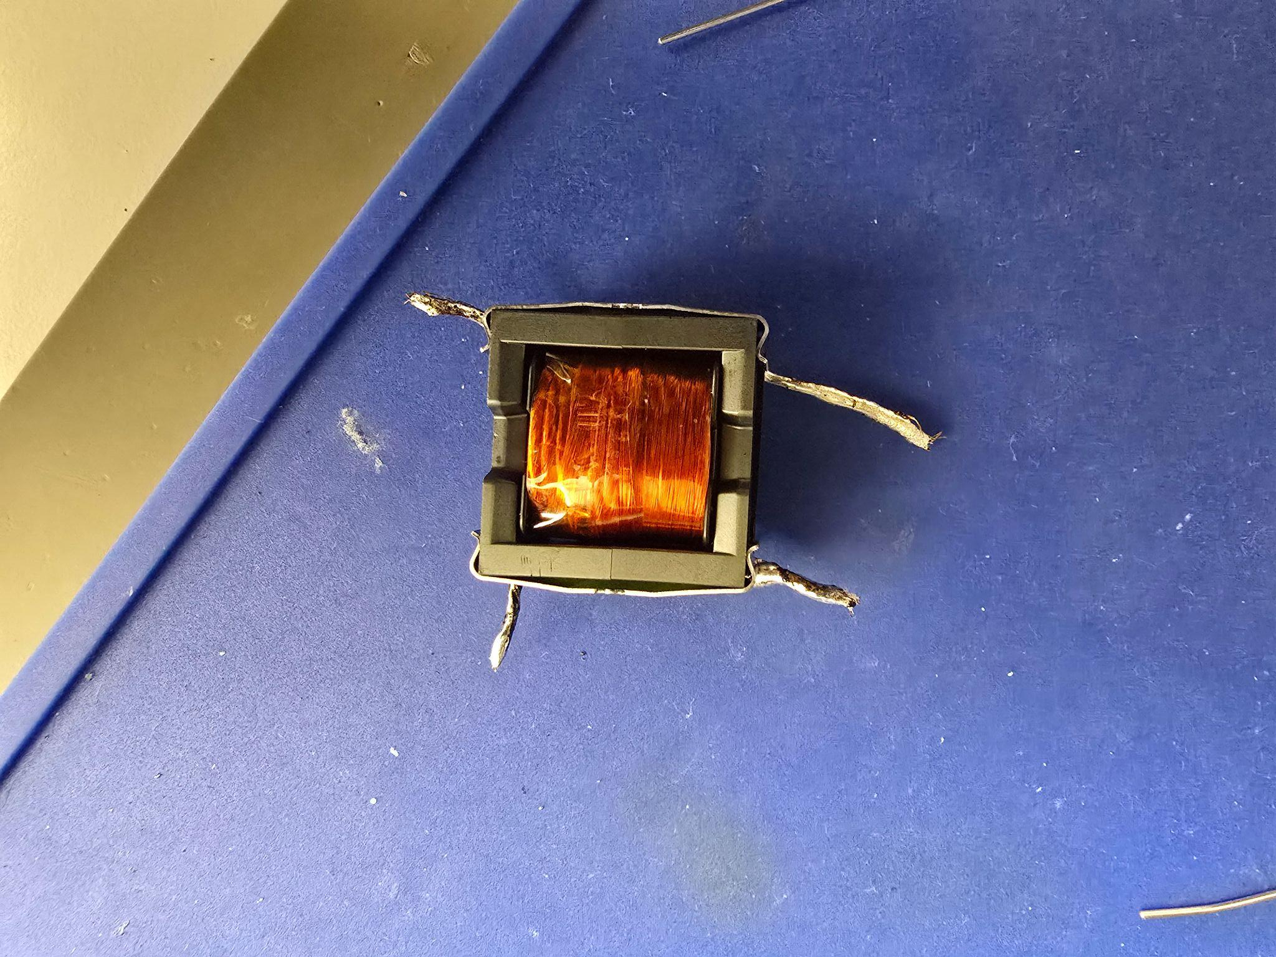
AC-AC Converter & Signals System – Accomplishments
Blake Hallam
During ECEN 403, I researched, designed, and simulated a subsystem that takes wall AC voltage as an input, sends the necessary signals to another subsystem, and converts the wall voltage into a high-frequency voltage for charging the scooter battery. I also selected the required components, created the schematic in Altium Designer, hand-built the transformer, and completed initial tests. Together, these efforts represent the design, implementation, and early validation of my subsystem.

Slide 5
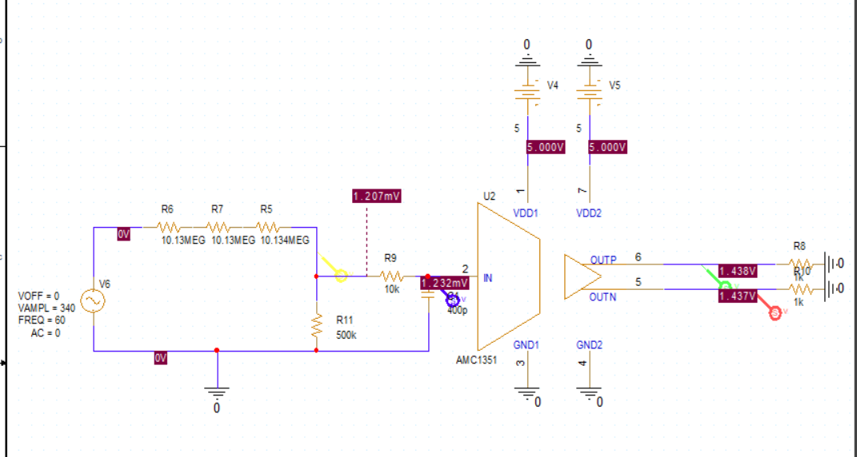
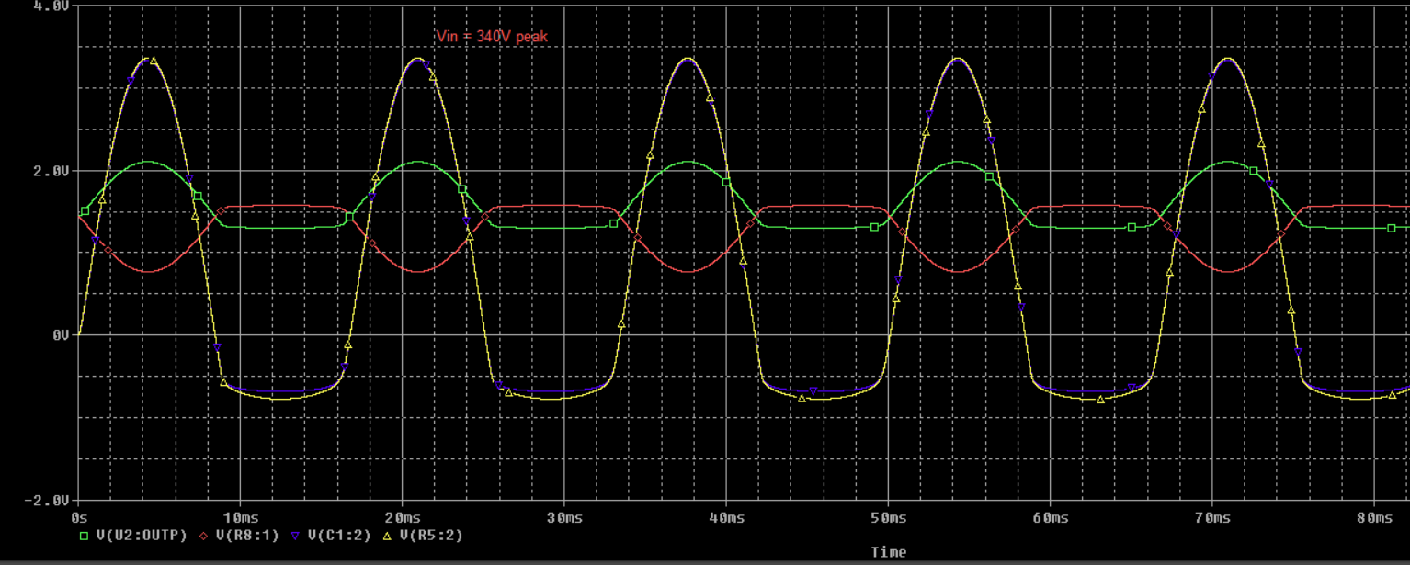
Isolation Amplifier Simulation
Blake Hallam

Slide 6
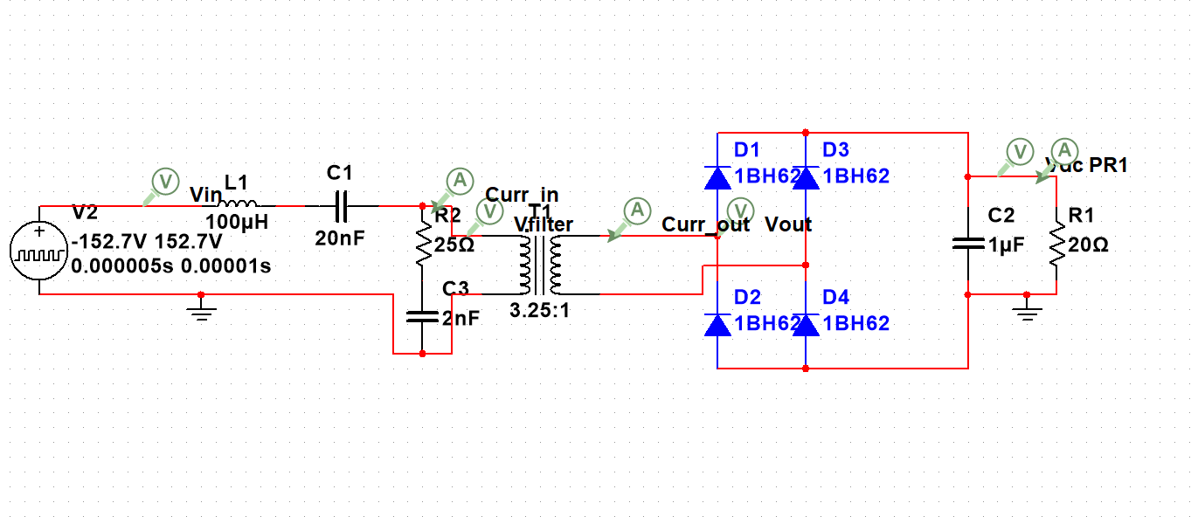
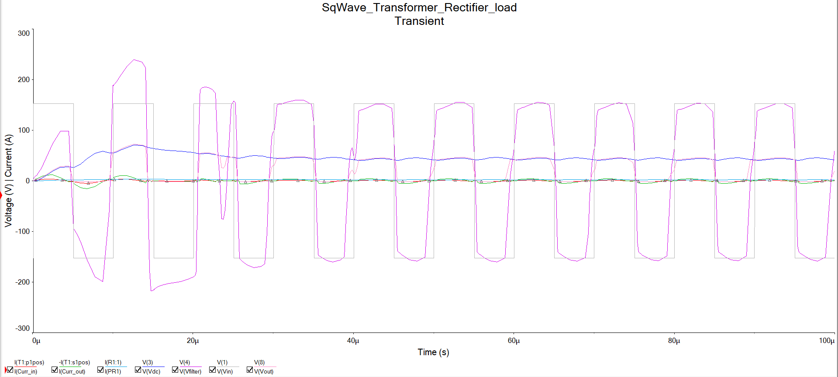
Transformer Simulation
Blake Hallam

Slide 7
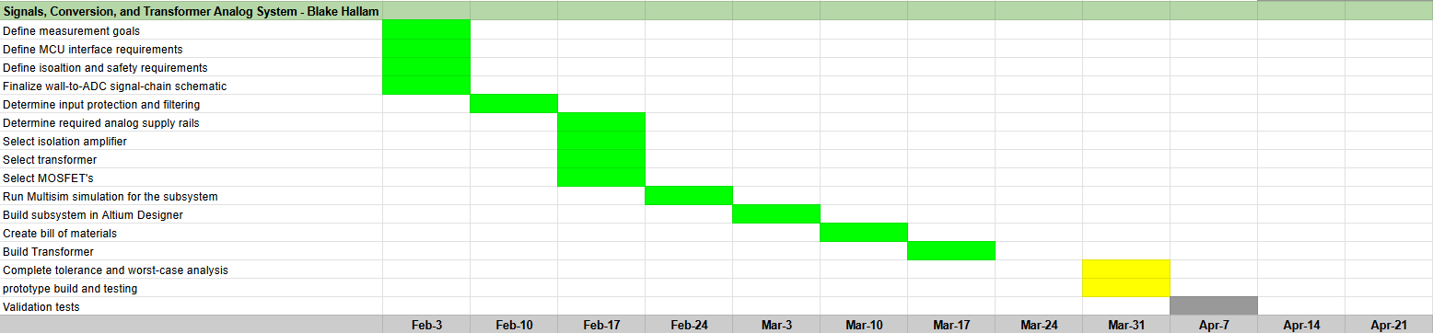
AC-AC Converter & Signals System – Execution Status
Blake Hallam

Slide 8
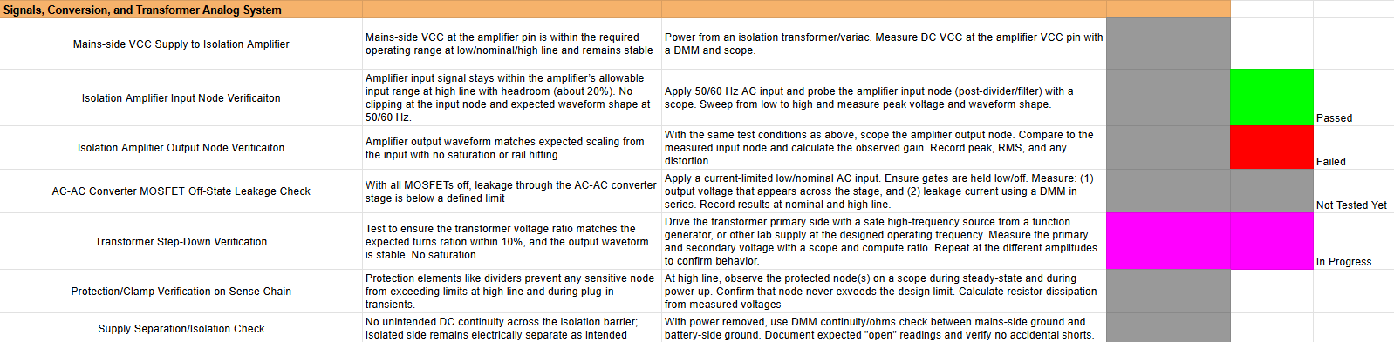
AC-AC Converter & Signals System – Validation Status
Blake Hallam

Slide 9
AC-AC Converter & Signals System – Remaining Tasks
Blake Hallam
Summary of remaining tasks in 403:
Finish testing the transformer.
Solder all components to PCB and test.
Validate complete subsystem once all components are mounted to PCB.
Summary of 404 tasks:
Mount PCB in scooter and successfully charge the scooter battery.
Debug if necessary, implement improvements/corrections where needed

Slide 10
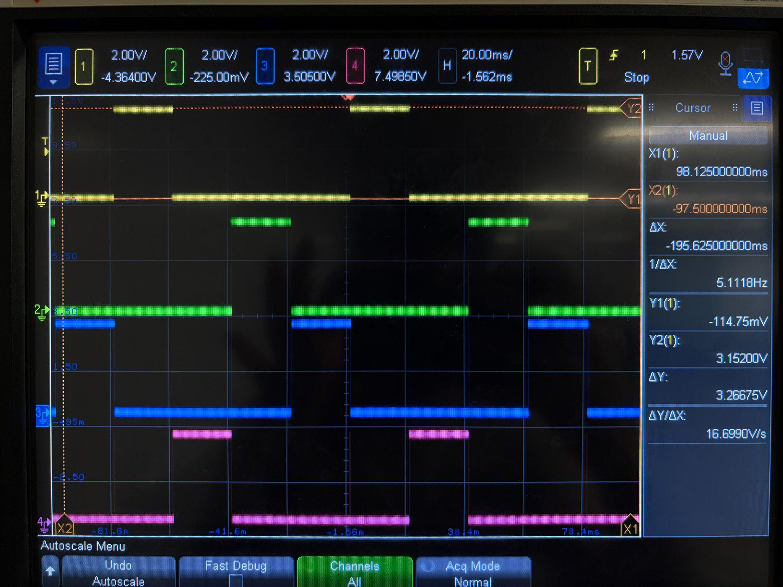
Matrix Control System - Accomplishments
Oscar Rubio
The Main Control Unit Sequence has been finalized, tested, and validated
Main Control Unit with CLB interconnects with proper gate signal outputs.
Switch Sequence Delay within the EPWM and delay counter
The initial EPWM setup with alternating Duty Cycles at 60 Hz
Main Control Unit Signal Testing

Slide 11
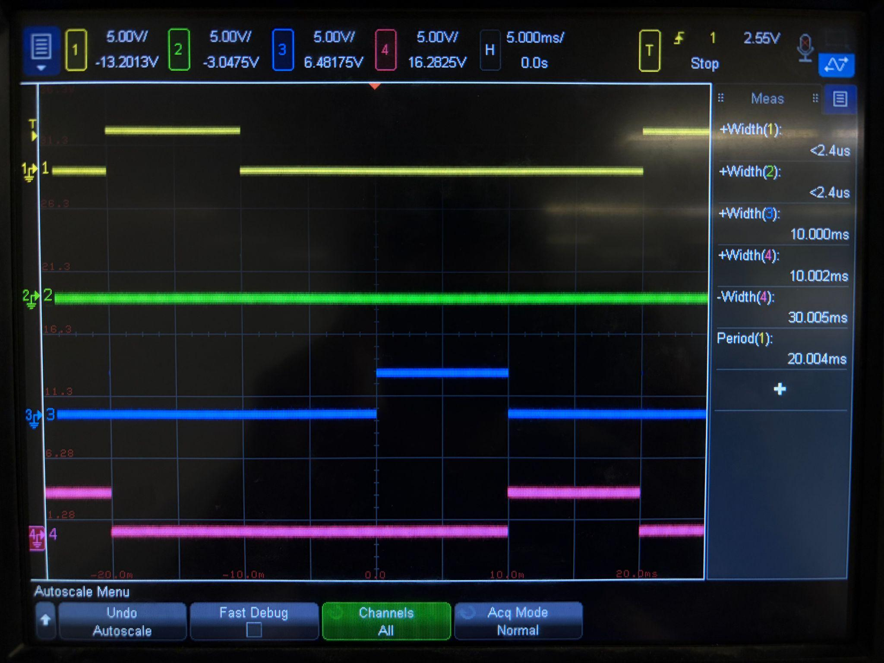
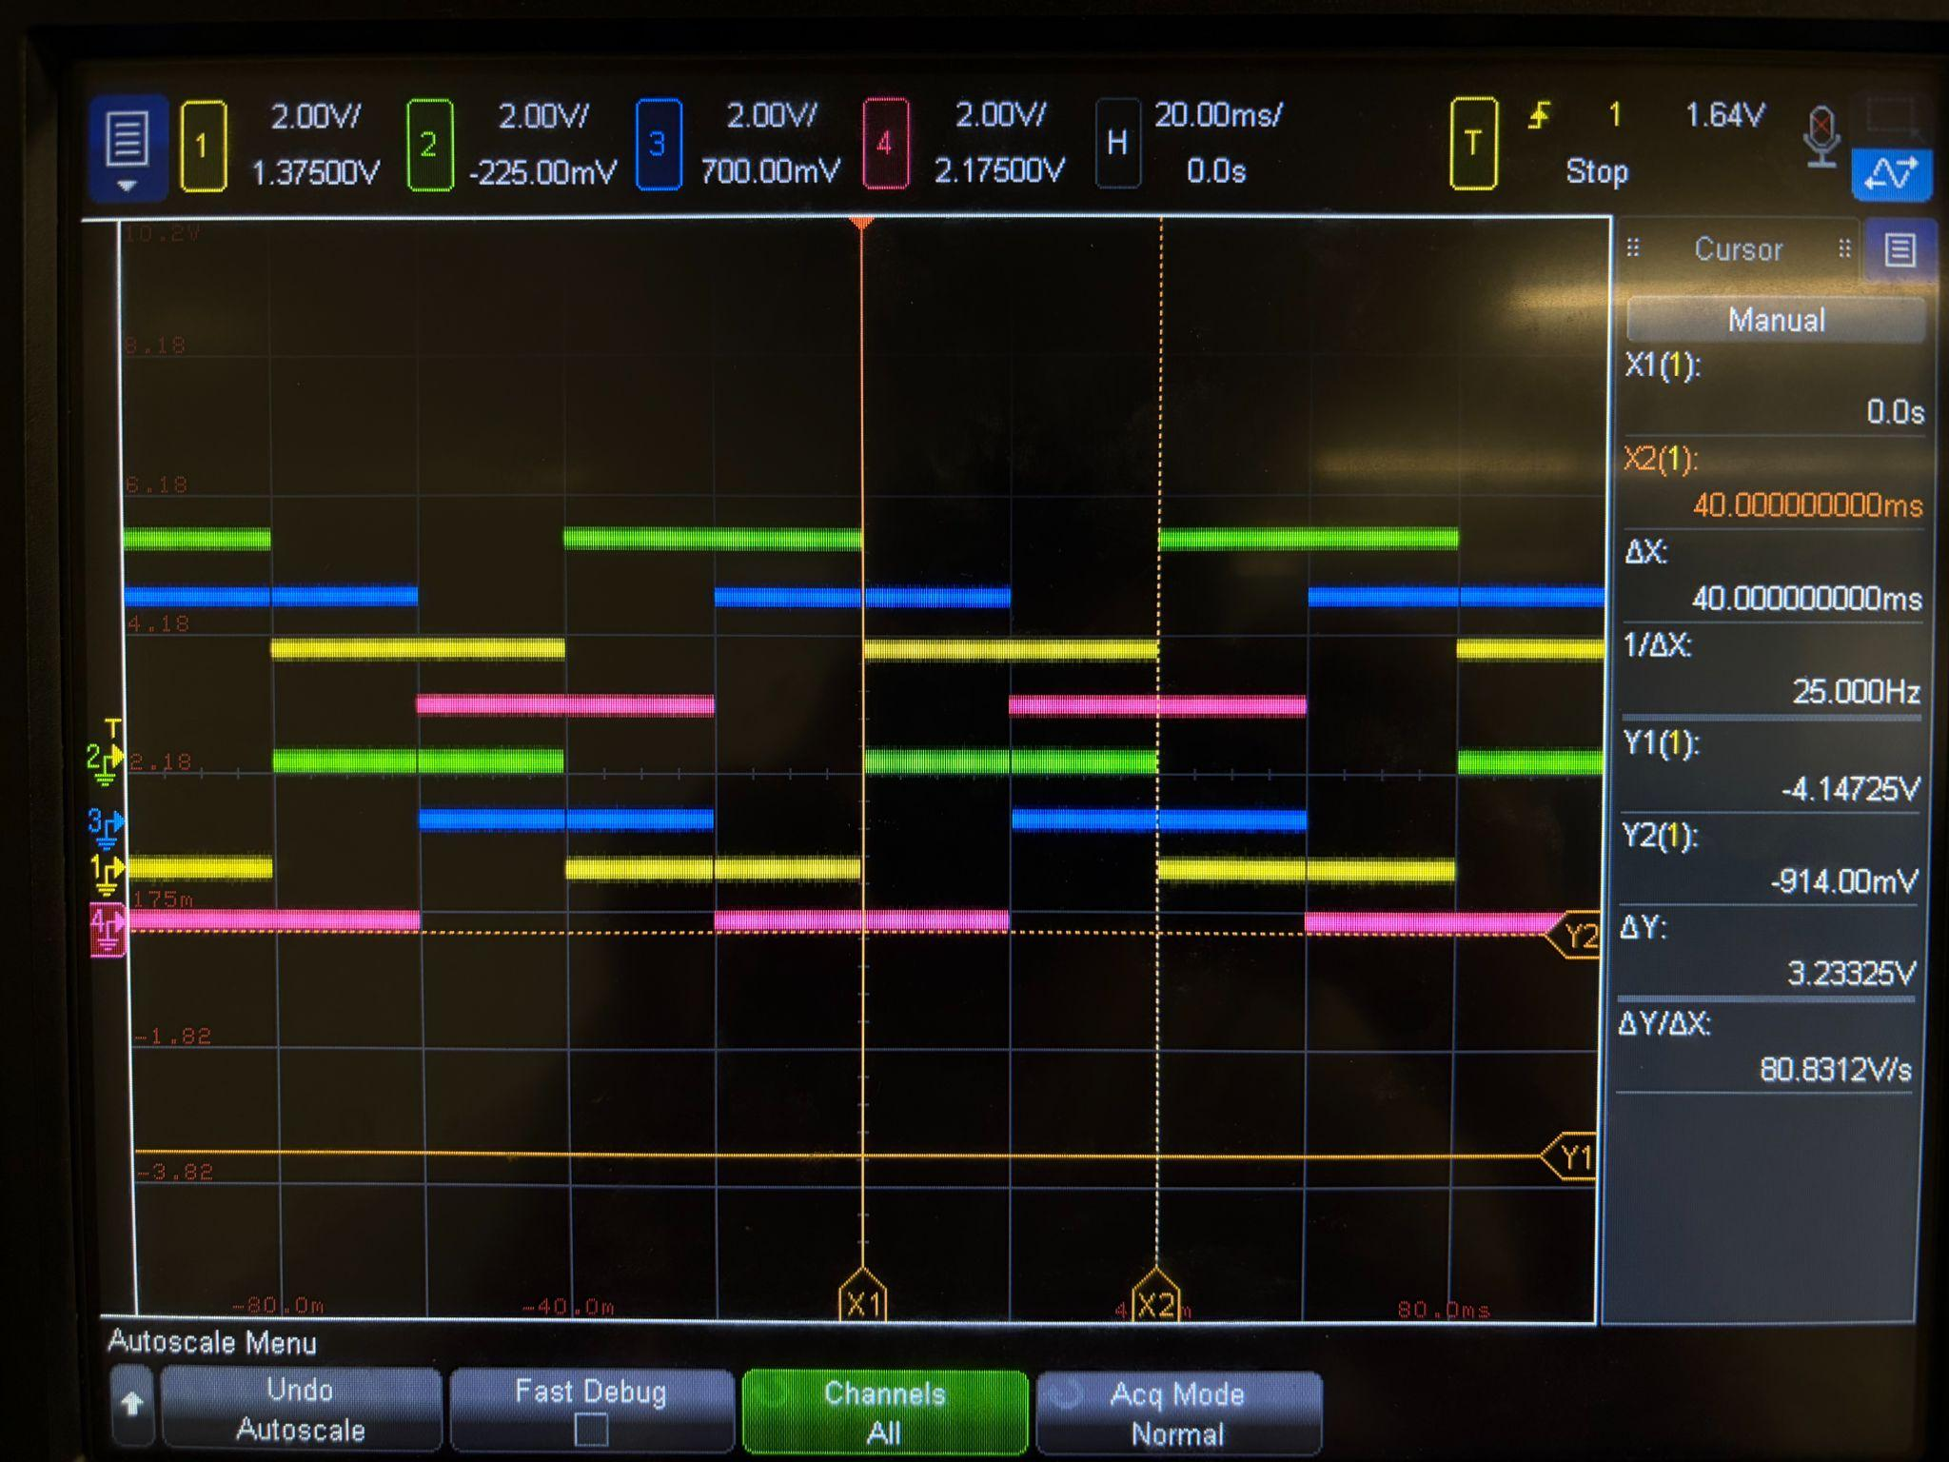
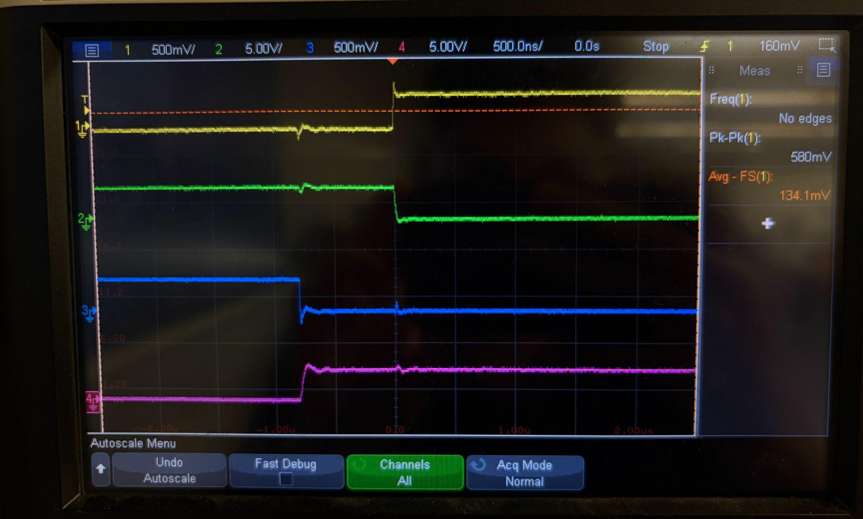
Main Control sequence when system is unsafe to work
Main Control with Gate Interconnect Signal for Overlap
Delay Counter Integrated into Control Sequence Gate Signals

Slide 12
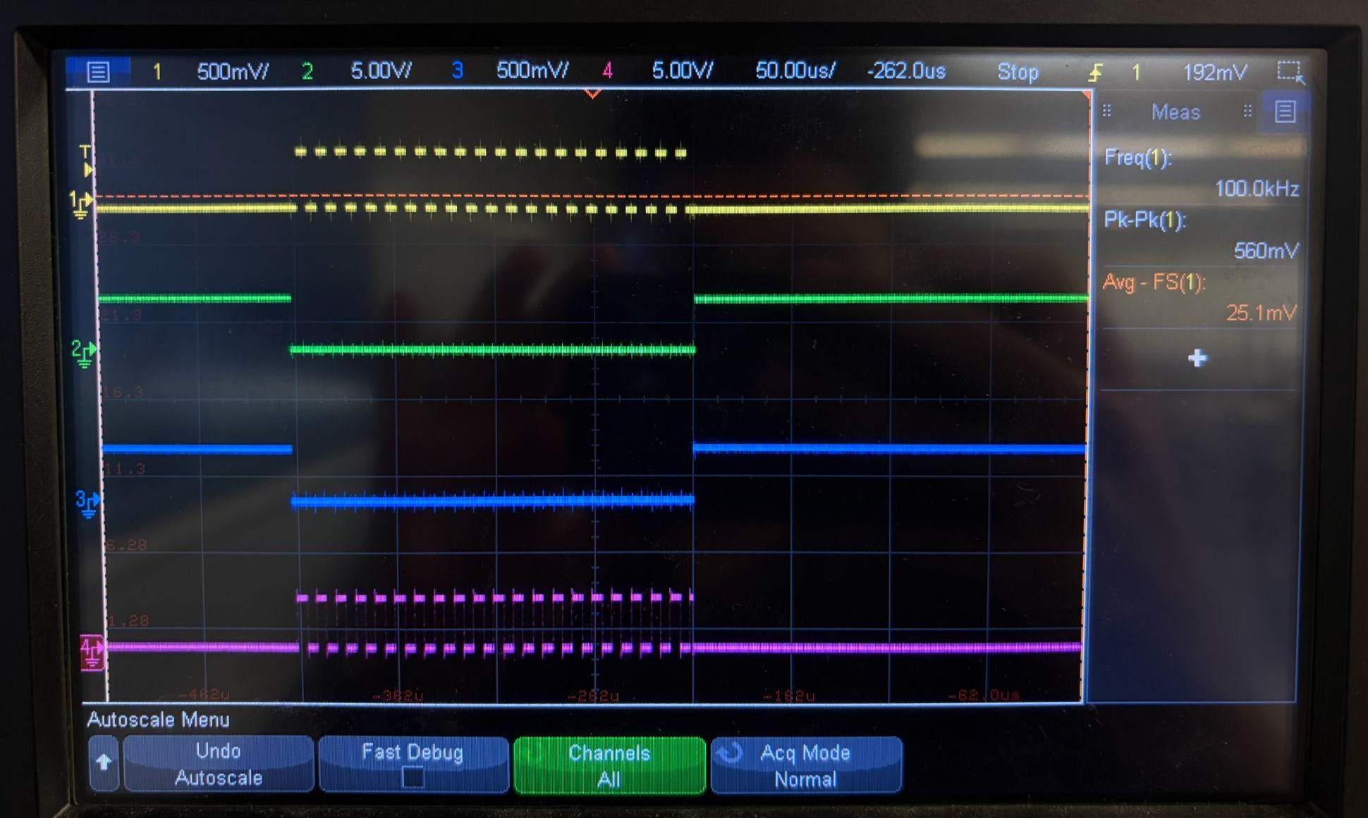
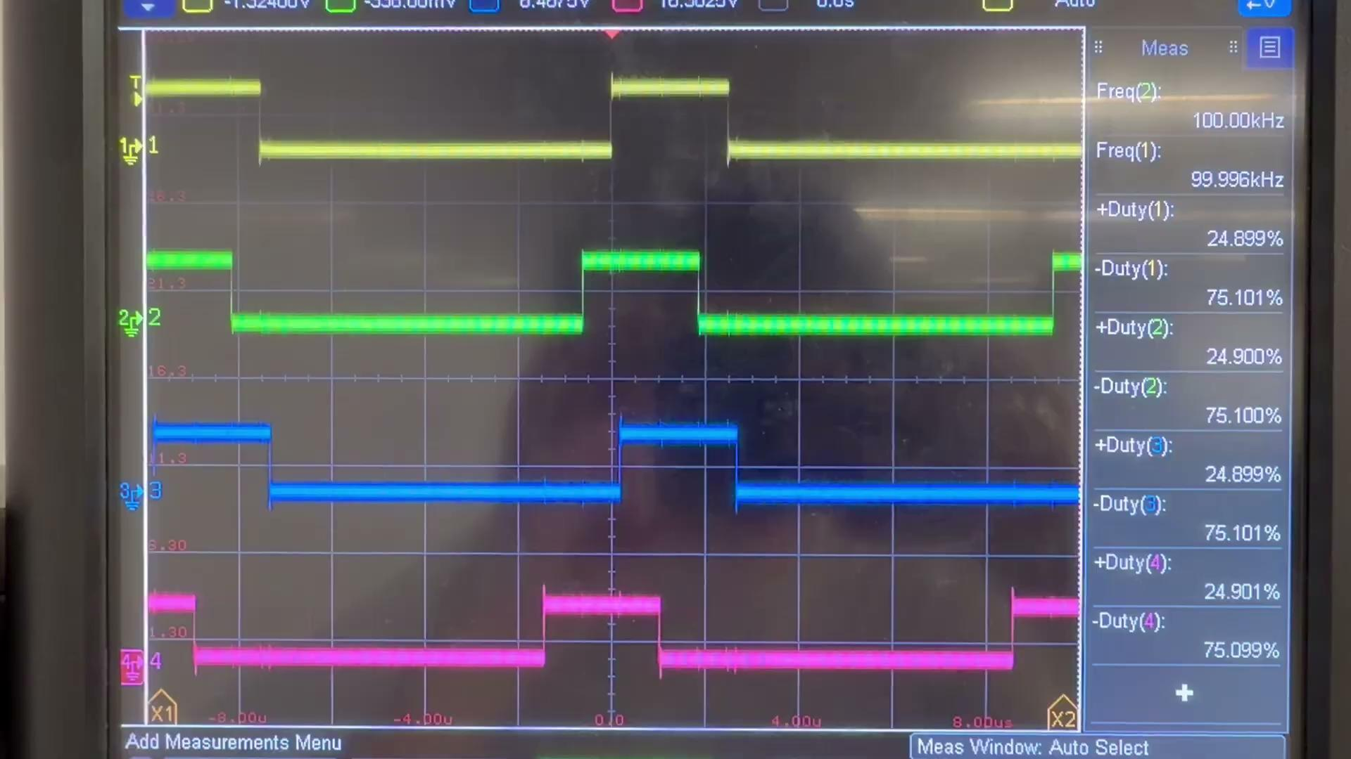
EPWM Setup with alternating Duty Cycle (25%,50%, 75%)
Switch Sequence (SA, SD) with EPWM Implementation

Slide 13
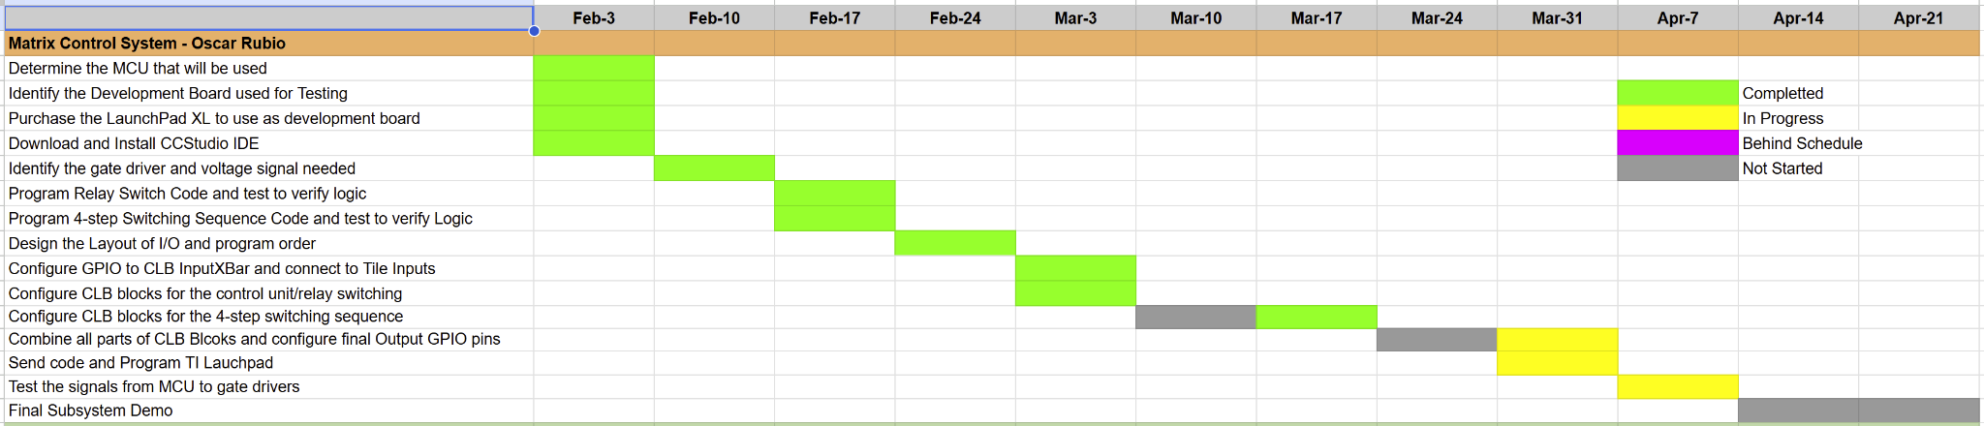
Matrix Control System – Execution Status
Oscar Rubio

Slide 14
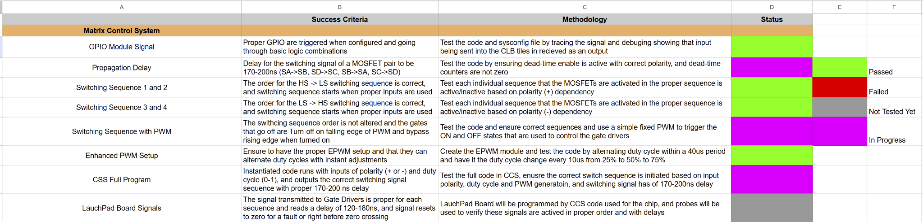
Matrix Control System – Validation Status
Oscar Rubio

Slide 15
Matrix Control System – Remaining Tasks
Oscar Rubio
Remaining Tasks for 403:
Fixing and testing the delay counter for the EPWM and Switching Sequence
Update the latch signal system to properly overlap for active gates and delay switch
Connect the EPWMs for the SB, SC gates and have the alternating switching sequence with EPWMs active
Test the full interconnected system with GPIO inputs at 60 Hz and output 100 kHz signals for active sequences.
Remaining Tasks for 404:
ADC configuration with system for the matrix inputs instead of hardcoded inputs
Final EPWM and combinational logic implementation that will connect signals from C2000 (CLB tiles) to the gate drivers

Slide 16
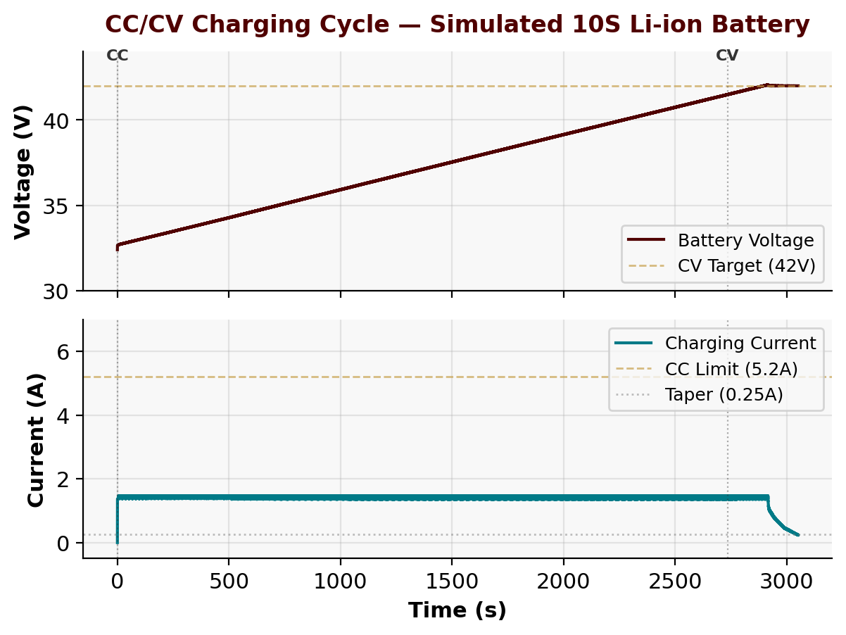
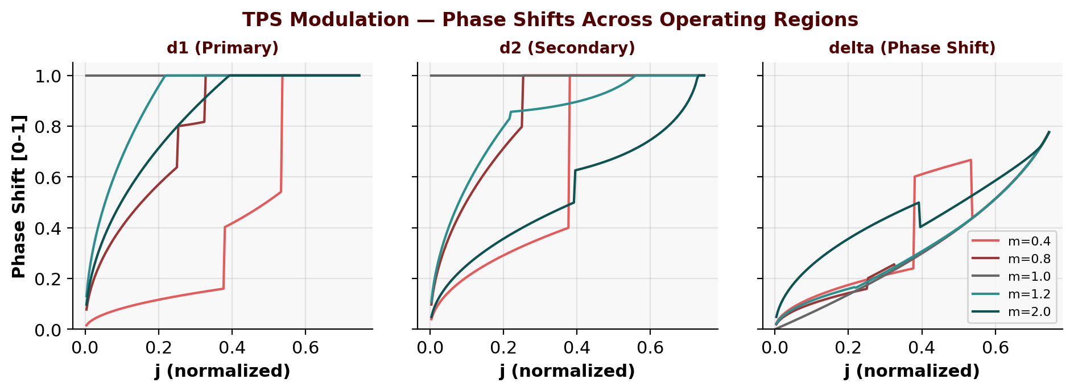
C2000 Firmware –Accomplishments
Connor Cottongame
TPS Modulation Solver: Implemented all 3 piecewise regions (closed-form R1/R3, Newton-Raphson R2) for Triple Phase Shift DAB control
CC/CV Charging Controller: Cascaded PI loops (voltage outer, current inner) with soft-start ramp, OVP/OCP fault detection, and taper termination
Mode Controller: Relay state machine (IDLE/CHARGE/DRIVE/FAULT) with mutual exclusivity, 50 ms relay settle, over-temp protection
DAB PWM + ADC + UART: 100 kHz phase-shifted H-bridge (ePWM1-4), 4-ch ADC sensing, 10 Hz UART telemetry with command
interface
Motor Control Driver: open-loop six-step commutation on ePWM5/6/7 (20 kHz), duty cycle control

Slide 17
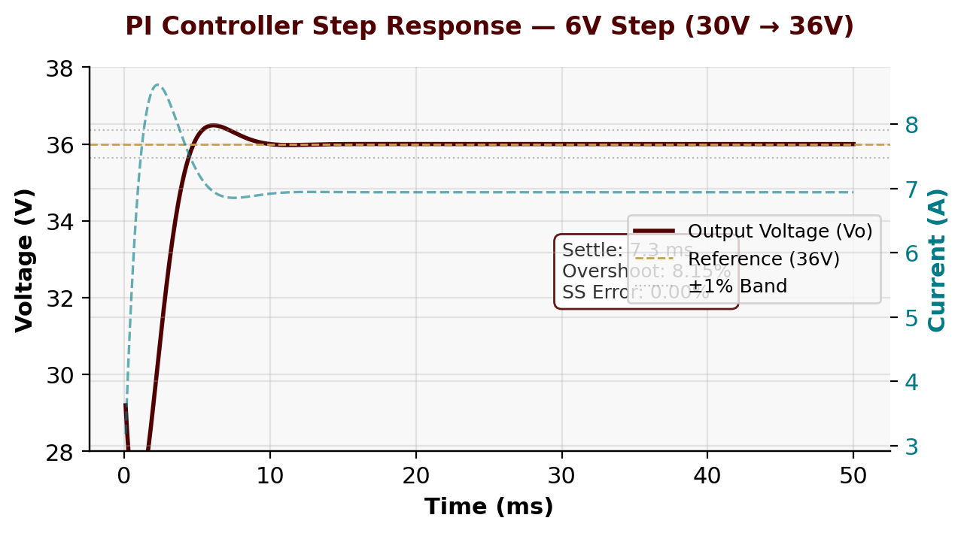
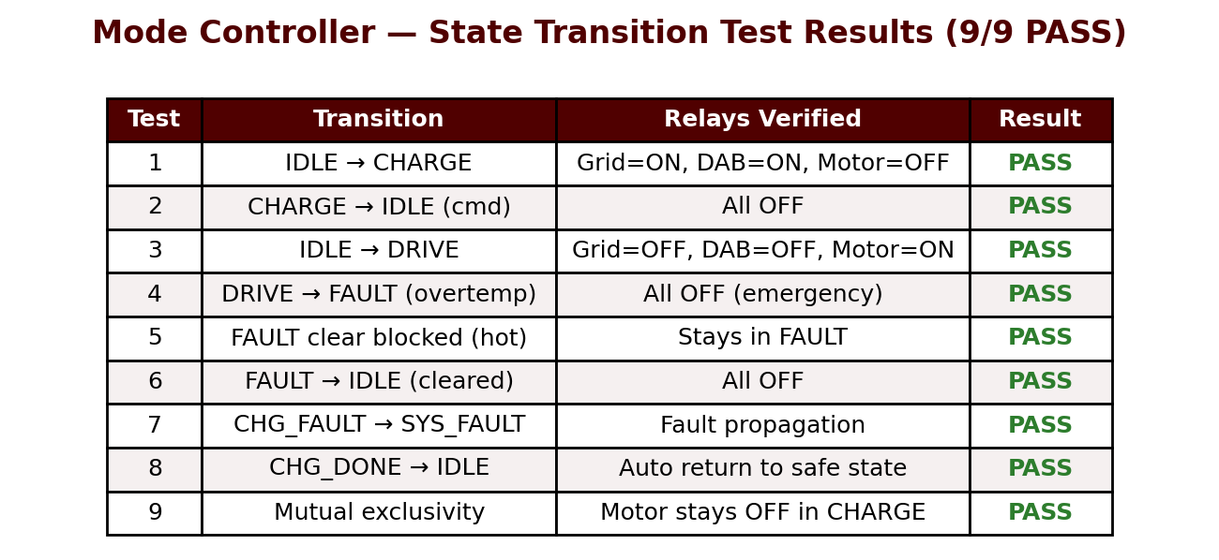
C2000 Firmware – Execution and Validation Status
Connor Cottongame
PI Controller: PASS — 6V step response settles in 7.3 ms, 8.15% overshoot, 0.00% SS error
CC/CV Charging Sim: PASS — Full cycle (Soft-Start → CC → CV → Done) completes, battery reaches 42V target with proper taper termination
Mode Controller: PASS — All 9 state transition tests pass (relay config, fault handling, mutual exclusivity, auto-return on charge complete)
TPS Solver: PASS — All 3 regions (R1 closed-form, R2 Newton-Raphson, R3 SPS) verified across 1600 operating points (m=0.2–2.0)

Slide 18
C2000 Firmware – Remaining Tasks
Connor Cottongame
Remaining for Project Demo
BMS Communication: Implement simulated UART-based BMS packet parsing (cell voltages, SOC, faults) with dashboard fault injection
OLED Display: SSD1306 I2C driver with status/charging/drive/fault screens (auto-switching, 2–10 Hz update rate)
Dashboard: Web-based real-time dashboard (Python + HTML) with TPS visualization, CC/CV curves, BMS simulator, and motor panel
For 404
Hardware integration: ADC calibration with real sensors, DAB PWM tuning on scope, CLA timing validation
End-to-end demo: charge cycle with scope captures, fault injection, motor spin, full dashboard telemetry

Slide 19
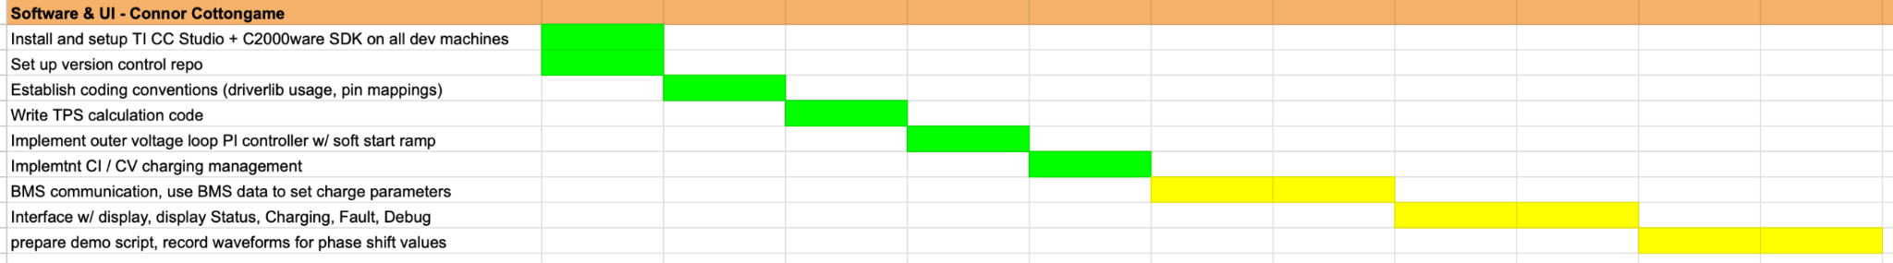
C2000 Firmware – Execution Status
Connor Cottongame

Slide 20
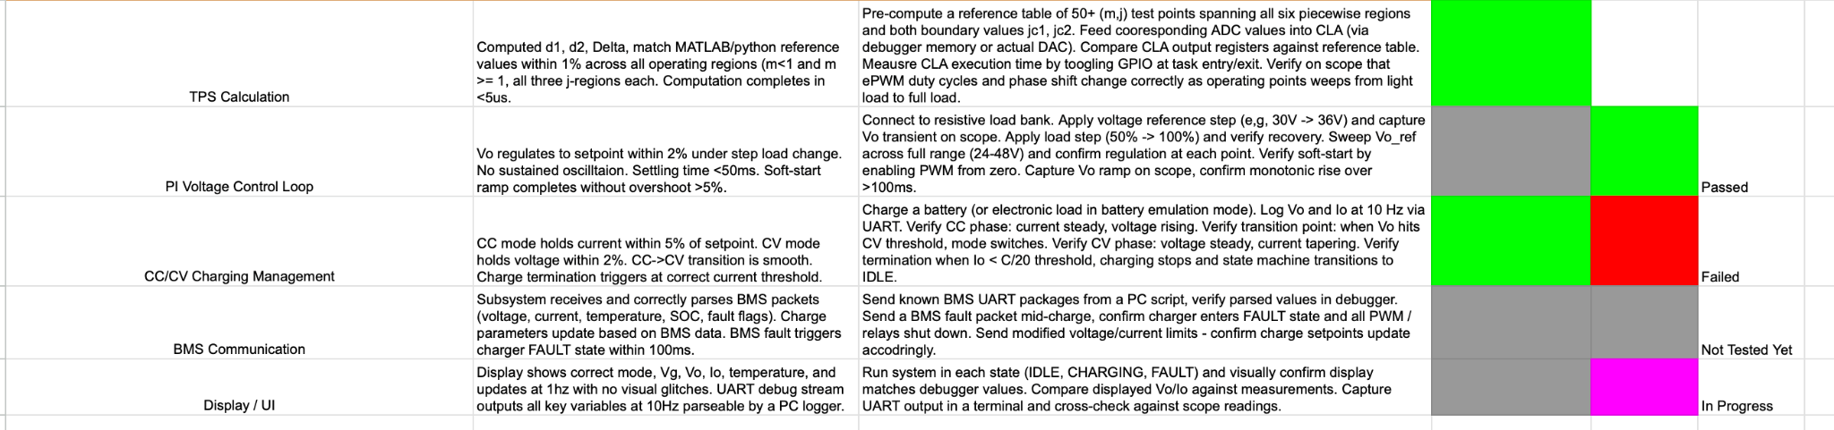
C2000 Firmware – Validation Status
Connor Cottongame

Slide 21
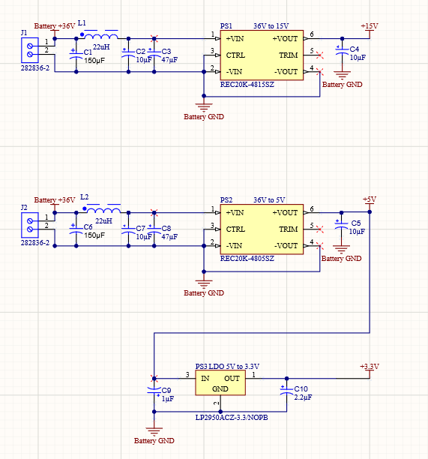
PCB Design – Accomplishments
John Dusterhoff
The PCB Design for the whole system has been built, finalized, ordered, and arrived.
Using and adjusting given schematics from other subsystems, designed the PCB in Altium.
DC-DC Converter section of the PCB was also fully within my subsystem.
Validation begins after soldering next week

Slide 22
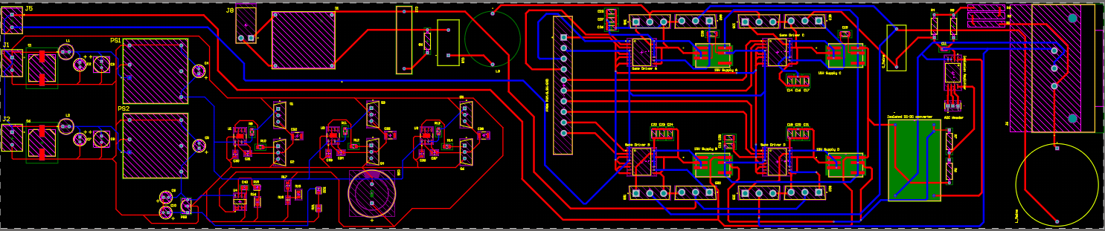
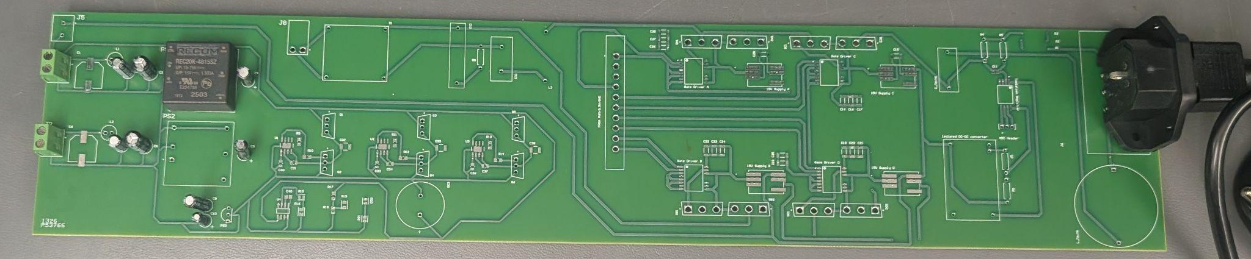
PCB Design – Accomplishments
John Dusterhoff

Slide 23
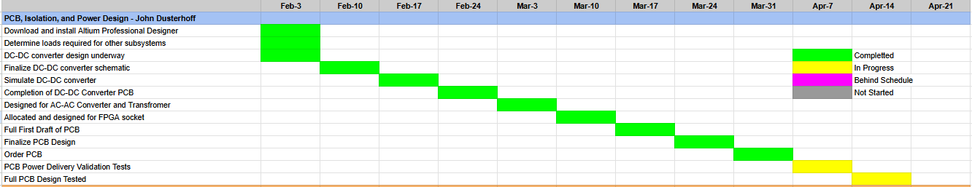
PCB Design – Execution Status
John Dusterhoff

Slide 24
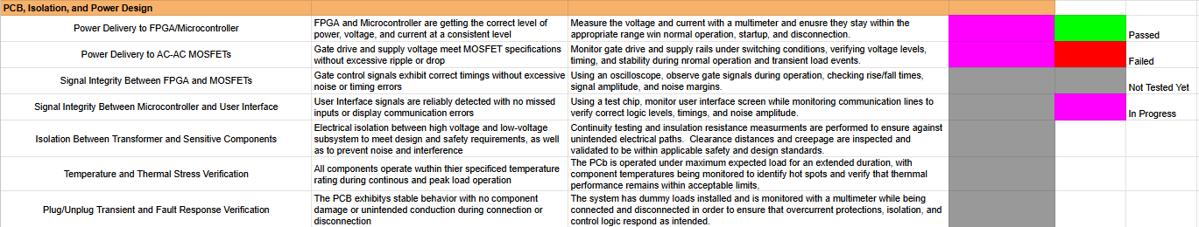
PCB Design – Validation Status
John Dusterhoff

Slide 25
PCB Design – Remaining Tasks
John Dusterhoff
Remaining Tasks for 403:
Solder ICs and other components onto PCB for Validation and Demo.
Validate Power Delivery
Validate Signal Integrity
Remaining Tasks for 404:
Integrate all subsystems onto the board
Adjust and finalize design if necessary in order to achieve all desired features.
Mount PCB in Scooter Chassis

Slide 26
From Matrix 1/Scooter Juice we thank for your attention.
Any Questions?
‹#›

